Slide 1
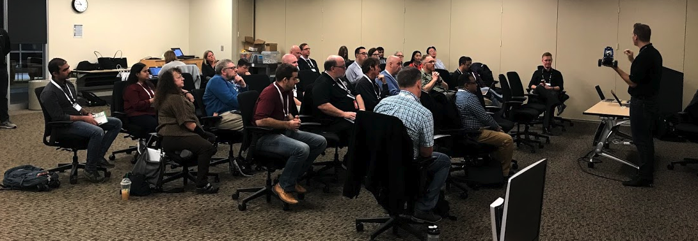
AI Racing League November 2019 Update

Slide 2
AI Racing League Vision, Alignment and Reach
The AI Racing League is a platform for AI education initiated out of the Optum Tech Social Responsibility program, envisioned for use by many businesses, with multiple stakeholders, mentors, participants and sponsors, reaching internal and external constituents.
“Let’s judge ourselves not on how we look in meetings. Let’s judge ourselves by the substance of impact we have on people’s lives.”
Andrew Witty, a CEO Conversation
“Let’s construct a campaign for employees to learn AI in a fun way.”
John Santelli, June 2019

Slide 3
Three Key Objectives
Create a fun hands-on event that will draw in skilled AI mentors
Hands-on events require high-touch (student/mentor = 3/1)
Leverage open-source DonkeyCar software and low-cost hardware Limited budgets for mentor charge-backs to account
Make the event accessible to everyone
Included non-technical staff
Take the fear out of AI
Create a testbed for AI-based learning management system
Graph of key concepts
Enable Learning content recommendation

Slide 4
November Event
Sprint 4
34 attendees
New “portable” GPU server configured by Jon Herke
High NPS despite technical problems in final drive function

Slide 5
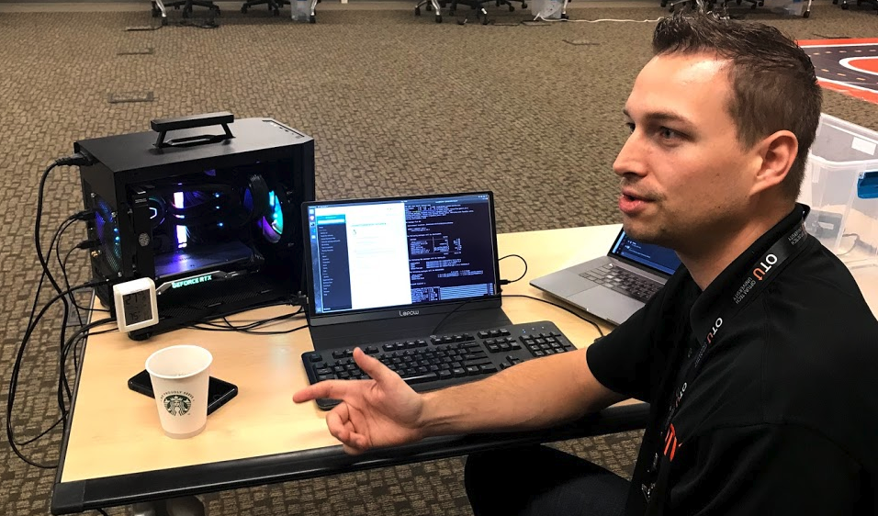
Jon Herke’s New Portable GPU Server
From 70 down to 25 pounds

Slide 6
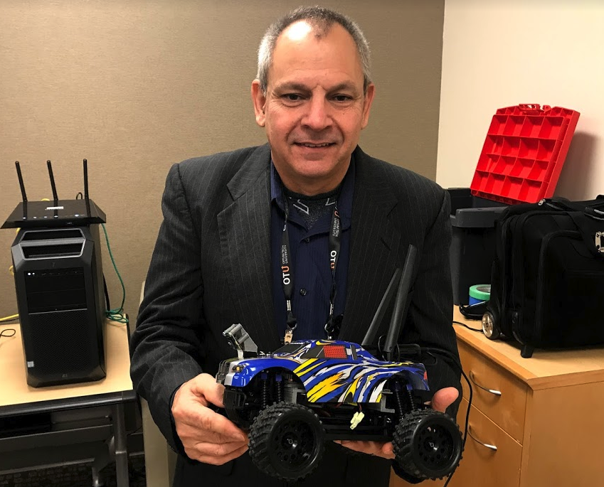
Mentors Purchasing and Building Custom Cars
Carl Boudreau – extensive 3D printing for customization of mounting

Slide 7
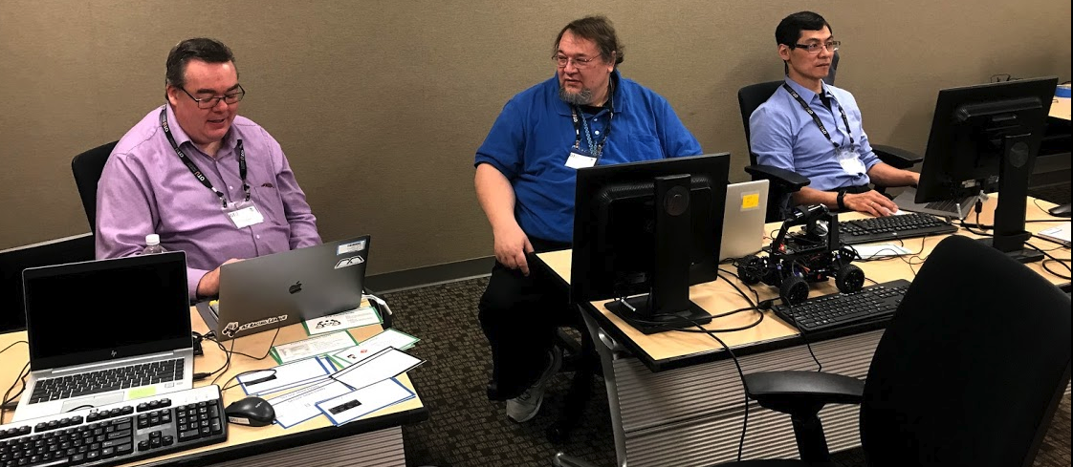
Better concept cards
Continue to get feedback on what concepts are imporant

Slide 8
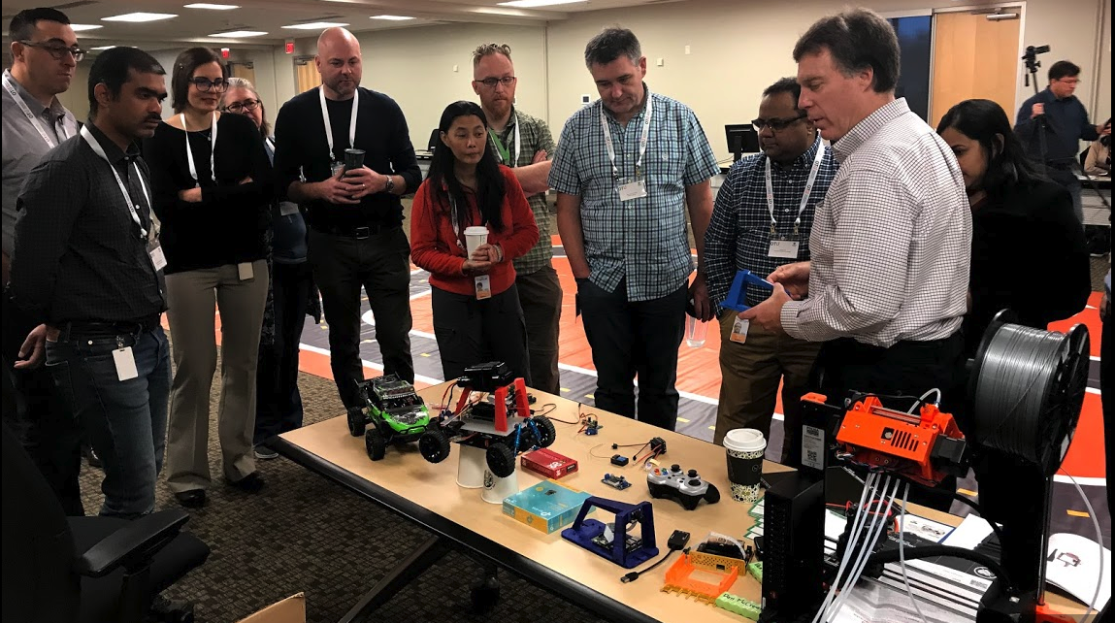
Customized hardware with 3D printer
New 3D
Printer

Slide 9
Next Sprint
Launch internal marketing campaign to find more mentors
Finding problems in the drive functions
New concept cards
OTU has new 3D printer
Better camera mounting
Github site updates

Slide 10
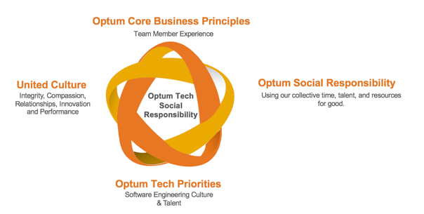
Optum Technology Social Responsibility Mission Statement
Enable and nurture social responsibility engagements that leverage Optum Tech team members’ knowledge, relationships and passion to serve communities they live in, elevate STEM knowledge and ultimately live our culture.
Get employees out into communities
Deliver a broad and long term impact globally
Align our social responsibility
@OptumTech_SR
Notes:
WHO
STEM being the main initiative of Optum Tech SR,
How people can get involved
If you’re working on STEM
- Tell us stories
- Send pictures
- The number of people (lives) you’re impacting
- Understanding the breadth and depth for our impact so encourage you to track your service hours no matter what you do
We also know there are many ways people are making an impact with their tech skills, so want to call out some pro bono efforts of the team and highlight a few people there.
Optum Technology is in a unique position with its talent pool to help drive Optum Impact through STEM focused work.
Get employees out into communities we operate to support UHG’s mission to help people live healthier lives and help the health system work better for everyone.
Deliver a broad and long term impact globally while optimizing the use of Optum Technology’s capabilities to drive successful social responsibility.
Align our social responsibility with the focus of Optum Social Responsibility as well as Optum priorities and United Culture Values
https://unsplash.com/photos/vCblQxO7oPY
Photo by Diego Morales on Unsplash

